Slide 1





CST2335 GRAPHICAL INTERFACE PROGRAMMING
Week 3 Using Constraint Layout

Slide 2
Agenda
Why ConstraintLayout?
Constraint Layout in Action

Slide 3
Why ConstraintLayout?
Constraint Layout was added to Android Studio 2.2 in 2016
It became the default layout of Android Studio because of its simplicity and ease of creating complex layouts
Constraint Layout simplifies the creation of complex layout in Android by making it possible to build most of your UI using only the visual editor in Android Studio
Constraint Layout comes with powerful tools that help to define complex layouts without having deep nesting.

Slide 4
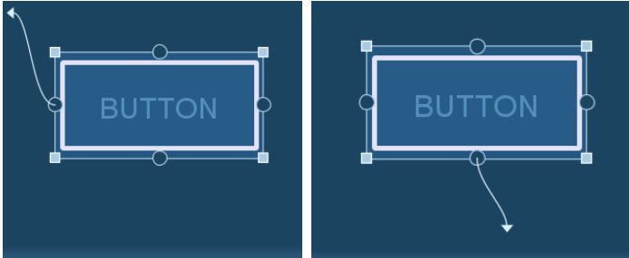
ConstraintLayout in Action
No need for defining an orientation like in LinearLayout
You only need to connect the view components to one horizontal and one vertical constraint

Slide 5
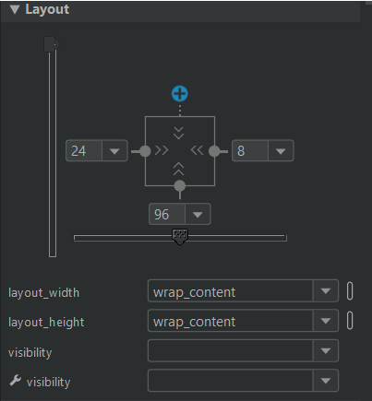
Inspector
This gives the iconified view of a single widget.
With it, we can set margins for each constraint edge of our widget. We can also use sliders to adjust the bias horizontally or vertically

Slide 6

Inference
This allows a user to automatically create constraints after positioning widget on a layout.
It looks like a magic wand in the Constraint Layout toolbar

Slide 7
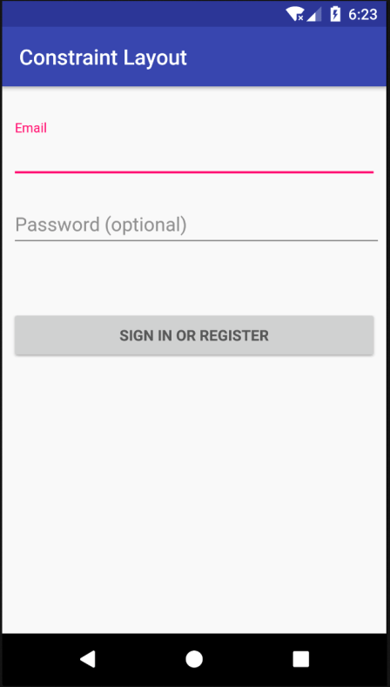
Exercise
Build the layout shown in the image using the Constraint Layout in Android Studio

Slide 8
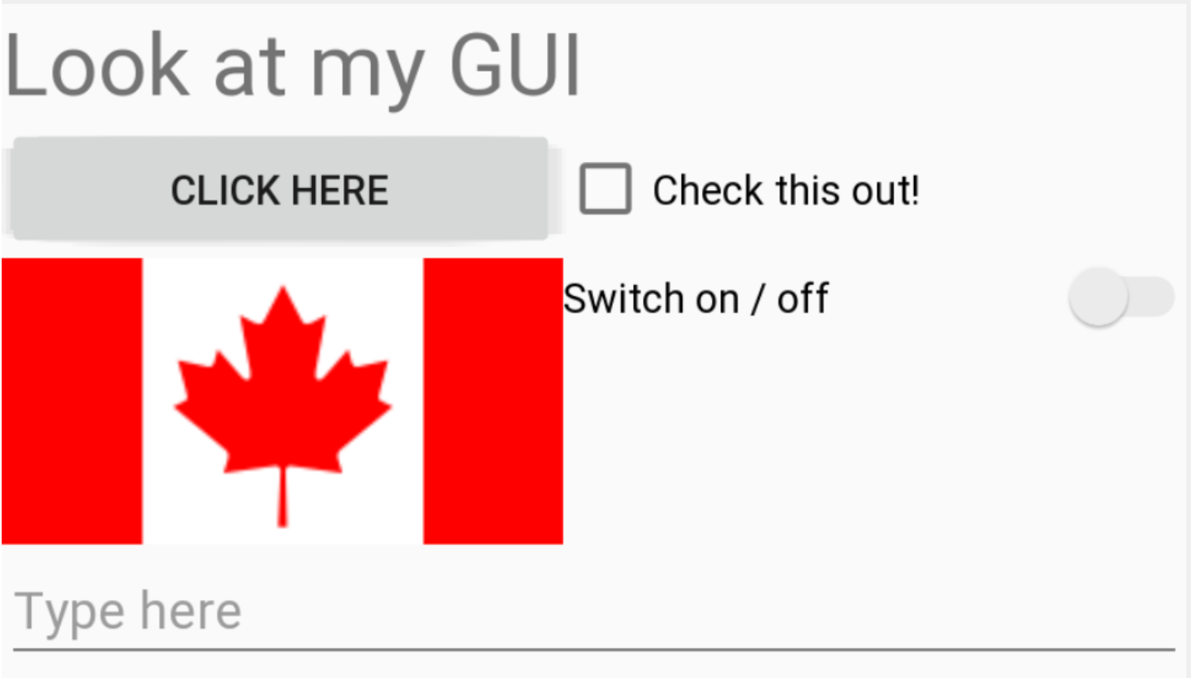
Exercise
Build the layout shown in the image using the Linear Layout in Android Studio

Slide 9
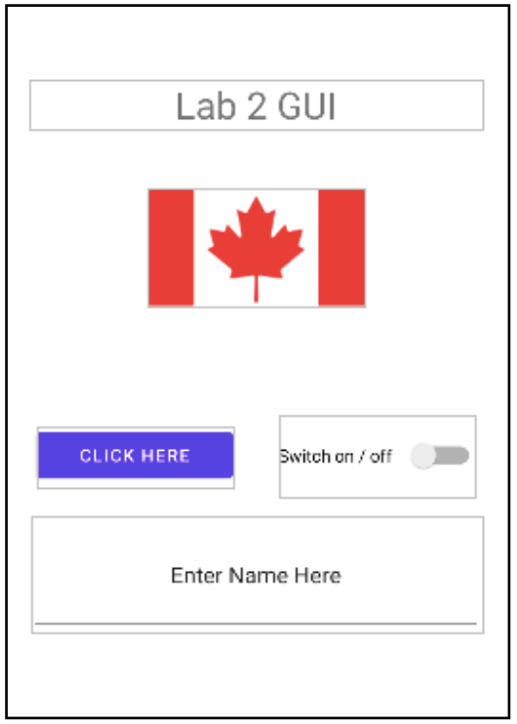
Exercise
Build the layout shown in the image using the Constraint Layout in Android Studio

